Slide 1

Airbus Aertothon 6.0
AIM (Aircraft Inspection and Monitoring)

Slide 2

Introduction
AIM: A two-Level CRM and Aircraft Inspection and Monitoring Software with state-of-the-art damage detection models that take care of the entire lifecycle of Aircraft Maintenance, Inspection & Repair, providing insights to a persona at a different level.

Slide 3
Features
Image Segmentation & Object Detection with YoloV9: Machine learning algorithms to assess the severity and extent of damage on aircraft surfaces, now it can detect.
Crack
Dent
Missing-head
Paint-off
Scratch
RAG LLM Chatbot Model: Trained on Airbus data, to help operators & technicians find quick resolutions without reading the entire Airbus operating & maintenance manual.
Image to Text: Using Google Gemini Pro, operators can upload a photo of an Aircraft Part that he is unaware of, and the LLM models will give them the details of that Aircraft Part.
CRM Software: Helps Airlines, MROs, and Airbus to maintain all customer-related data at one single place and drive their customer success journey through insightful analytics.

Slide 4
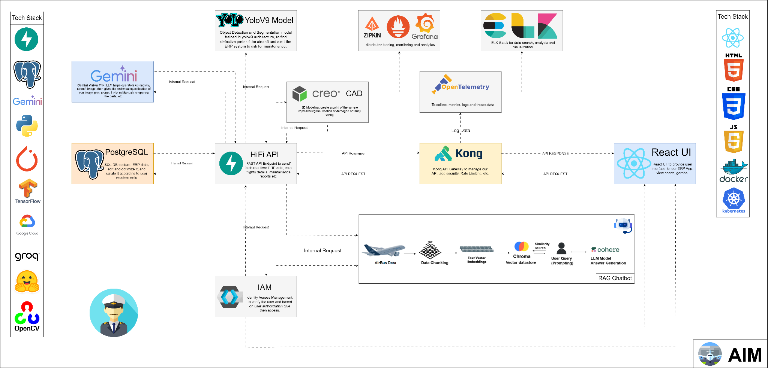
Project Architecture

Slide 5
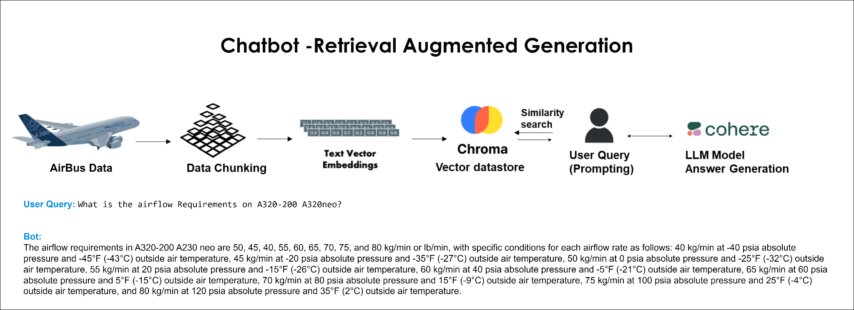
Chatbot Generative AI RAG (Retrieval Augment Generation) Architecture

Slide 6
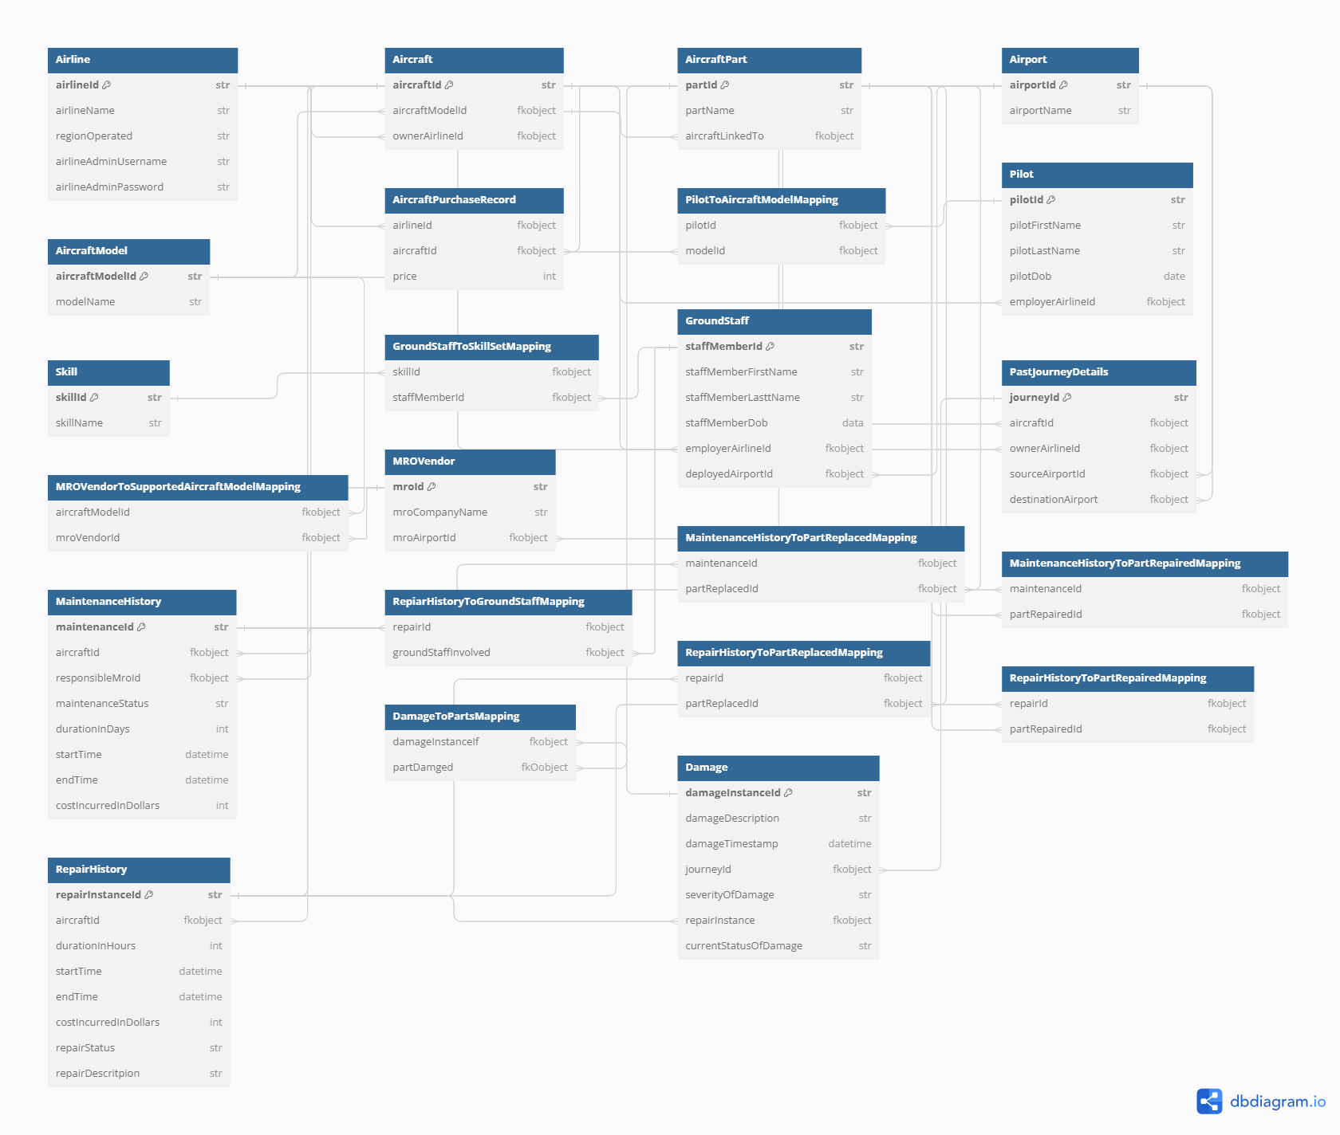
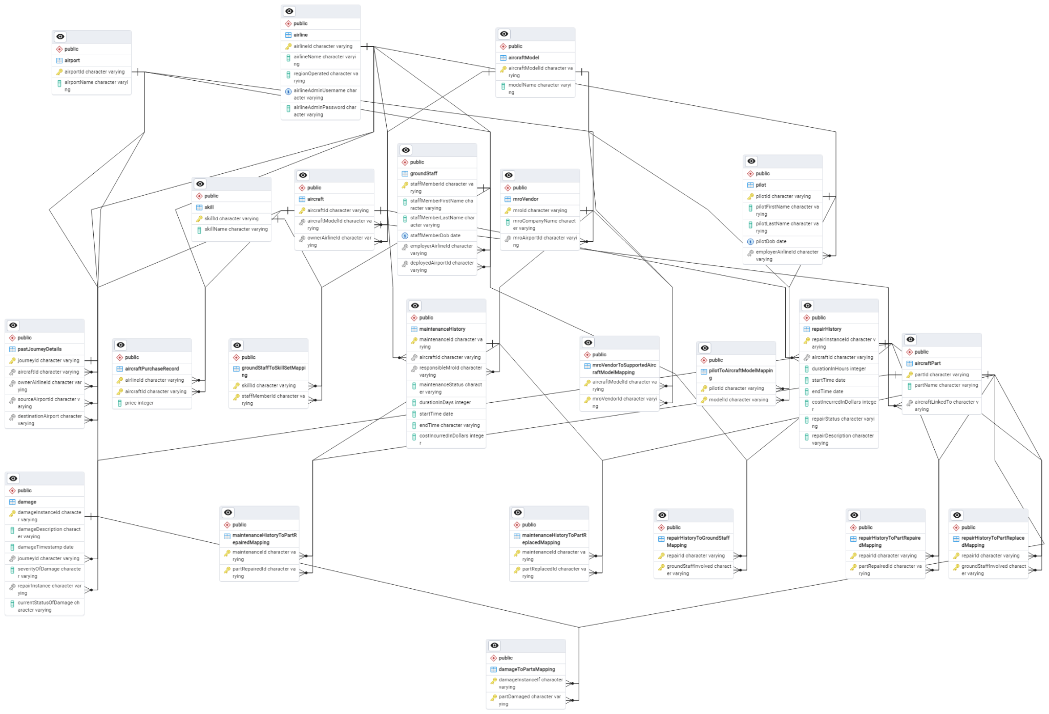
Database Entity–relationship Diagram

Slide 7
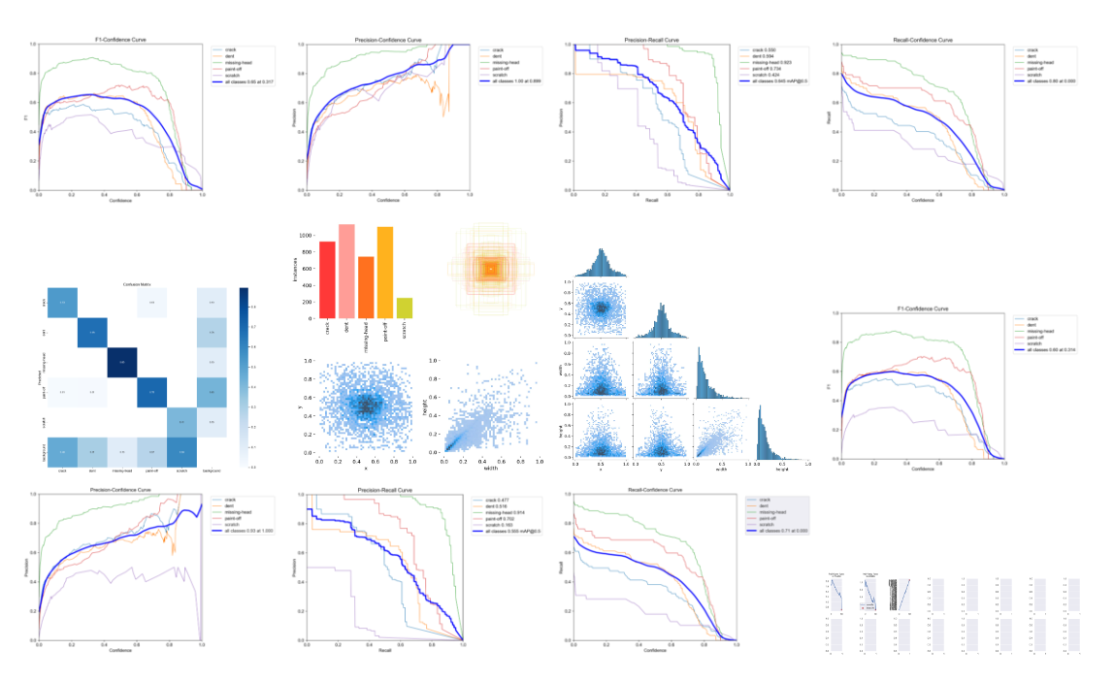
YoloV9 Object Segmentation & Detection Metrics

Slide 8
Integrating everything
We have a state-of-the-art damage detection model
We have sufficient data to draw useful insights
Now we need to integrate all of this to provide airlines a streamlined execution that not only help them keep aircraft compliance standards up to date but also integrates well with the existing solutions

Slide 9



Personas involved
MRO
A solution to bring all of them together
Airline
Ground staff

Slide 10


Yet-another-CRM
Healthcheck
Damage and repair history
Maintenance history
Staff skills
Latest images analysed by CV models
….
Yet-another-CRM, enabling airlines maintain MROs data, compliance data, repair and maintenance history all at a single place.
MROs can run their customer success journey and airlines can maintain spend analysis.
Airbus will get insights on aircraft repairs to shape their R&D roadmap.
Can be integrated with existing ERP solutions (like SAP HCM, S/4 HANA backend, etc.) with rich set of APIs
Damage detection model
Ground staff
MRO
Airlines ..
Web app

Slide 11
Sky High Insights: Unraveling the Power of Airline Data Analytics
Data analytics refers to the process of analyzing, interpreting, and deriving insights from raw data to support decision-making and drive business outcomes. In today's digital age, where vast amounts of data are generated every second, data analytics plays a crucial role in extracting valuable insights that can inform strategic initiatives and enhance organizational performance.
Predictive Maintenance: Utilizing advanced algorithms to analyze aircraft health data and anticipate maintenance needs, minimizing downtime and optimizing maintenance schedules.
Flight Operations Optimization: Analyzing historical flight data, weather patterns, and air traffic to optimize routes, altitude, and fuel consumption, reducing operational costs and environmental impact.
Safety and Performance Monitoring: Real-time monitoring of aircraft safety and performance through data analytics, enabling proactive identification of safety hazards and ensuring compliance with aviation standards.
Customer Experience Enhancement: Personalizing in-flight services and amenities based on customer feedback, preferences, and behavior patterns, enhancing the overall passenger experience.

Slide 12
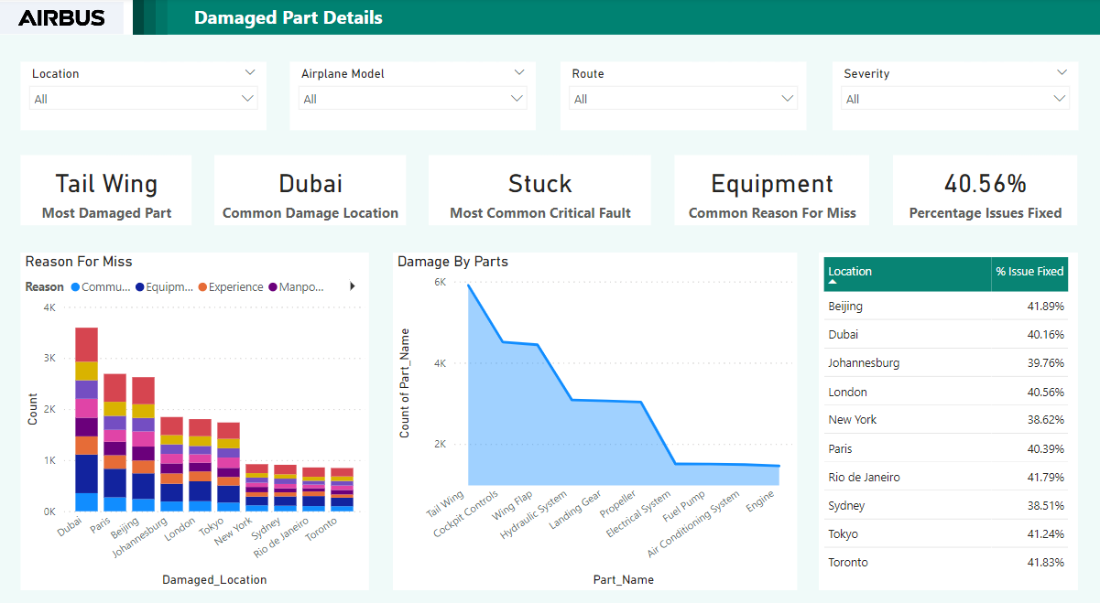

Slide 13
Insights from Maintenance Data Analysis
Top Damaged Parts:
Chart displaying parts with the highest frequency of damage.
Insight: Identify critical components requiring proactive maintenance interventions.
Root Cause Analysis:
Chart depicting reasons for damages not addressed during maintenance.
Insight: Uncover recurrent issues for targeted improvement in maintenance protocols.
Resolution Tracking:
Table showcasing resolved issues by location.
Insight: Monitor efficiency and effectiveness of maintenance interventions across different facilities.
Maintenance Insights Overview:
Cards: Data presented in visually engaging cards format showcasing the most common faults encountered.
Insight: By analyzing these prevalent issues, we can target troubleshooting efforts effectively and implement mitigation strategies proactively.
Slice and Dice: Dynamic filters for precise data analysis:
Slicers: Users can dynamically filter data based on severity, location, airplane model, and route taken using interactive slicers in Power BI.
Insight: Interactive slicers empower stakeholders to uncover hidden trends, enabling targeted interventions and optimizing operational efficiency.

Slide 14
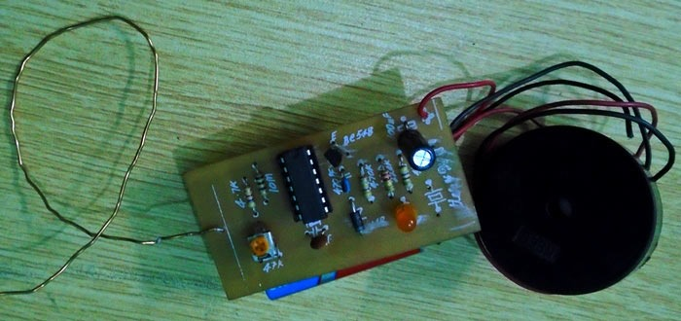
Identifying faulty wires
Object detection models can be leverage to identify rusty/ broken wires
Thermal images can be leveraged to identify any heat up wire that could possibly be a short circuit
Hardware solutions: voltage drop testing, impedance testing etc. can be deployed within the aircraft
Broken Wire Detector Circuit using IC CD4069

Slide 15
Thank You
It’s not just a rocket science it’s about building aircrafts

